Slide 1
BUSQOM 1080 Logistic Regression II
Fall 2020
Lecture 20
Professor: Michael Hamilton

Slide 2
Lecture Summary
Today: More on logistic regression
Recap simple logistic regression [10 Mins]
Logistic Regression as Prediction [10 Mins]
AUC and ROC [10 Mins]

Slide 3
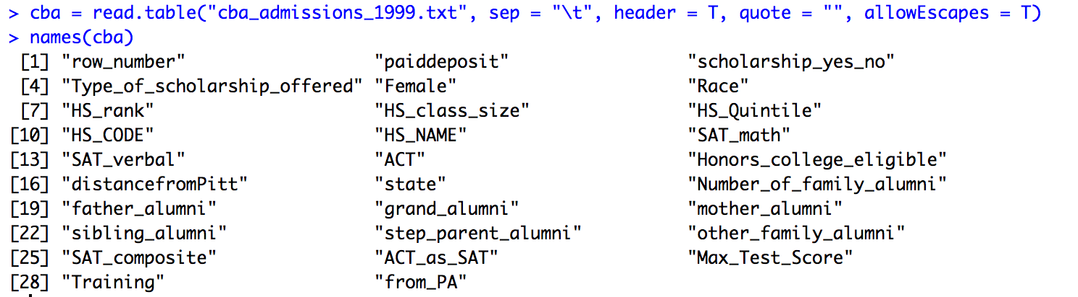
Data for lecture
880 Observations of students who applied to cba in 1999

Slide 4
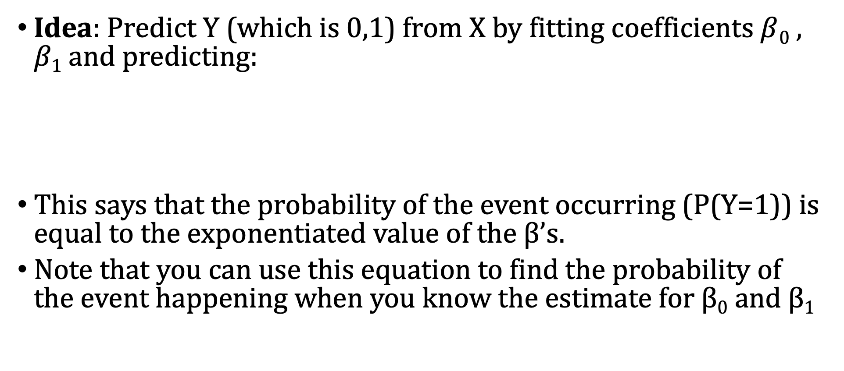
Last Time: Logistic Regression
Idea: Predict Y (which is 0,1) from X by fitting coefficients $β$₀ , $β1$ and predicting:
This says that the probability of the event occurring (P(Y=1)) is equal to the exponentiated value of the β’s.
Note that you can use this equation to find the probability of the event happening when you know the estimate for β₀ and β₁

Slide 5
Last Time: Logistic Regression
In logistic regression we are estimate a linear equation to predict the natural logarithm of the odds of success (the “log odds”).
The inverse of the logit function is
Some algebra shows that the model is equivalent to saying that:
Def: Odds Ratio

Slide 6
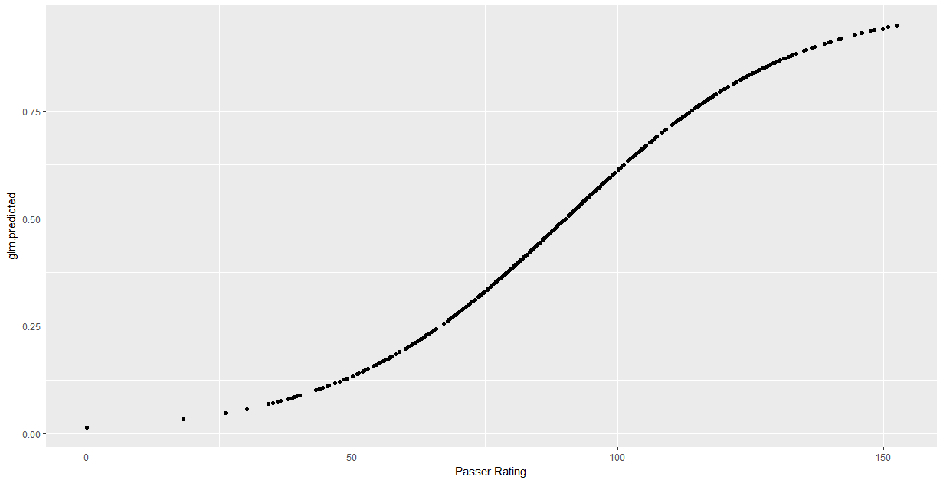
Last Time: Logistic Regression
Greater than 50%
probability of Y = 1
Pr(Y = 1)
Greater than 50%
probability of Y = 0
X

Slide 7
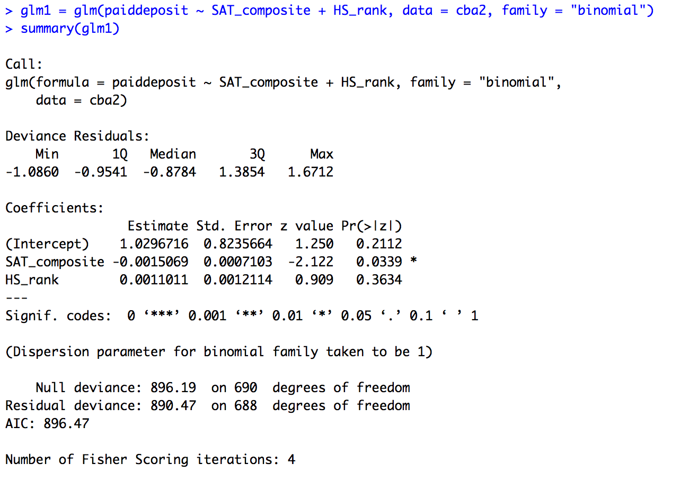
Last Time: Logistic Regression
Logistic regression versus linear regression:
Use glm() instead of lm()
Same formula
Tell R to use logit link (family = “binomial”)
Use summary() function to view results
Results include table of coefficients & model fit

Slide 8
Predicting with Logistic Regression
Sometimes we want to not just estimate the probability of an event, but make an actual prediction!
Ex: Given a dataset, we want to make a model to predict whether new incoming customers will click an ad or not. Not enough to just make a statement about the probability of a click, now we want to commit to click or no click
We can do this with logistic regression by setting a threshold
Example: Classify all points as 1 with >.5 predicted probability and 0 otherwise.
Questions of Interest: Does the model correctly classify observations?
What is the best way to measure the performance of prediction model?
Two ways to measure the prediction accuracy of logistic regression with a threshold
Contingency tables (confusion matrix)
Receiver operating characteristic (ROC) curves

Slide 9
Contingency Tables
Motivation: Logistic Regression with a threshold predicts new observations as 0 or 1. Often we care not only whether or not the model predicts correctly, but when it makes mistakes.
Classic example: In viral testing, much worse to call a sick person healthy (and thus not treat!) than a healthy person sick.
A Contingency Table is a way of representing the error of a prediction model that shows what kinds of errors are made.
Four categories:
True positive
True negative
False positive
False negative
 |  | Predicted |  | Sum
 |  | 0 | 1
Observed | 0 | True Negative | False Positive | Actual Negatives
 | 1 | False Negative | True Positive | Actual Positives

Slide 10
Sensitivity and Specificity
Two statistics to summarize a contingency table
Sensitivity = True Positives/Actual Positives
(aka the true positive rate)
Specificity = True Negatives/Actual Negatives
(aka the true negative rate)
 |  | Predicted |  | Sum
 |  | 0 | 1
Observed | 0 | True Negative | False Positive | Actual Negatives
 | 1 | False Negative | True Positive | Actual Positives

Slide 11
Sensitivity and Specificity
Example: Consider a test that can be used to detect a disease
A test with high sensitivity is one that is good at correctly identifying or detecting the disease
A test with high specificity is one that is good at correctly ruling out the disease
Ideally, we want both the sensitivity and specificity numbers to be high! We will see examples of this in the Zoom session.
Unfortunately this is not always possible. There can be a tradeoff between these two metrics corresponding to how loose/conservative the threshold is.

Slide 12
Beyond Sensitivity and Specifity: ROC
The ROC Curve plots the true positive rate (sensitivity) versus the false positive rate (1-specificity) as threshold varies from 0 to 1.
We use this plot because it shows the tradeoff between sensitivity and specificity (any increase in sensitivity will be accompanied by a decrease in specificity) for a fixed logistic regression model.
The Area Under the Curve (AUC) is a measure of accuracy (closer to 1 is better) that we can generate from the ROC curve. We’ll see an example in the next slide
The larger the area under the curve, the more accurate the model’s predictions.
More generally the higher the AUC, the better the relationship between the features and the response variable.

Slide 13
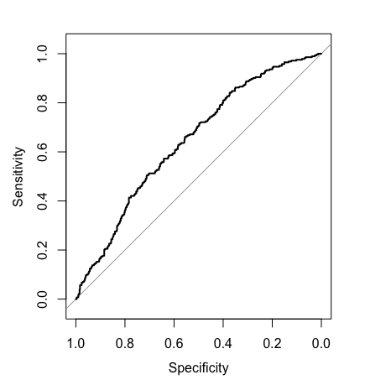
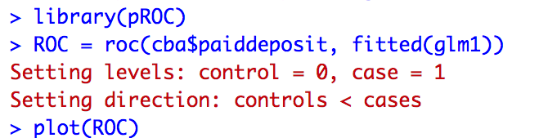
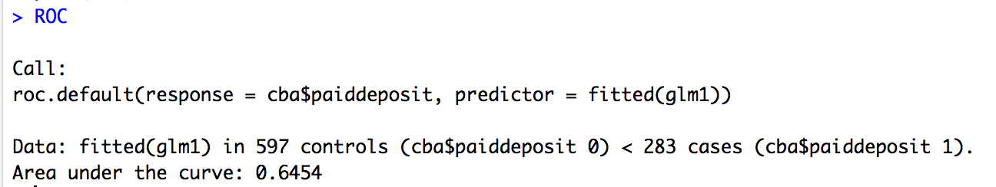
ROC Curve Example in R
install.packages("pROC")

Slide 14
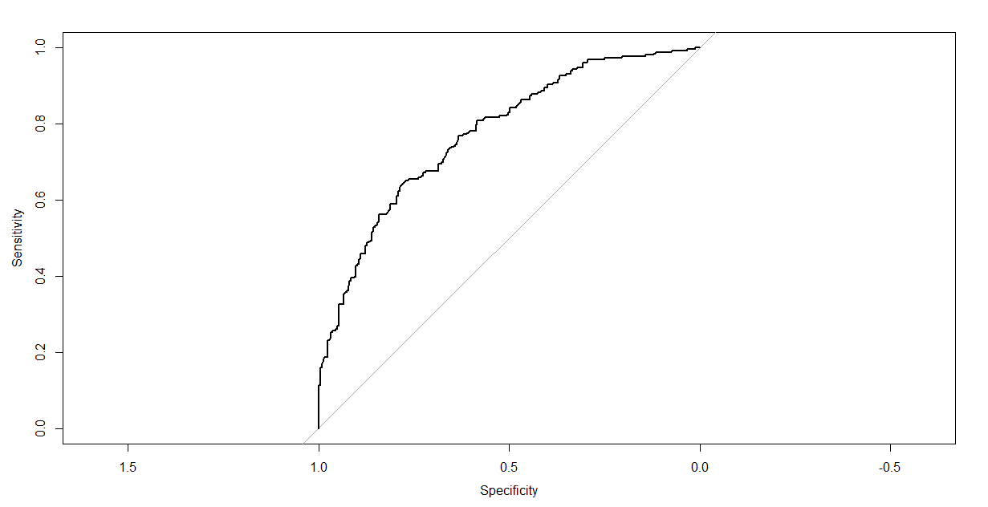
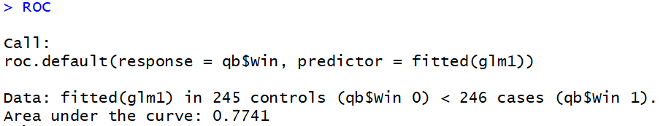
Assessing a model based on how well it classifies observations
The ROC curve plots sensitivity and (1-specificity) for a sequence of cutoff points (e.g., 0.1, 0.2, 0.3,…,0.9)
The area under the curve tells us how good our model is at classifying observations. AUC is always between .5 and 1. It is a good metric for measuring the performance of logistic regression models .
Perfect model: AUC = 1
Goal: AUC significantly greater than 0.5

Slide 15
Extension: Multinomial Logistic Regression
Problem: Suppose response variable has multiple (k) levels or categories, can we still us a logistic regression method to learn the relationship between feature data and response level?
Yes we can! We won’t cover it in depth in this class but it would be excellent to explore this further on your final projects.
How it works: Multinomial Logistic will produce predicted probabilities for each category, for each observation.
To use Multinomial Logistic Regression for prediction, observations are typically classified into the category with the highest predicted probability instead of threshold.

